Slide 1
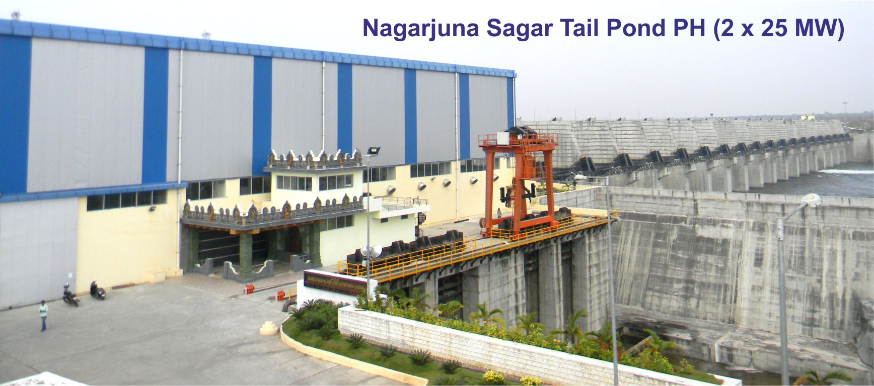
NAGARJUNA SAGAR TAIL POND DAM

Slide 2


Slide 3
CONTENTS
CONCEPT OF HYDRO POWER PLANT
OVERVIEW
CONTROL SYSTEMS
COOLING WATER SYSTEM
DESCRIPTION OF TURBINE
SWITCH YARD LAYOUT

Slide 4
Concept of hydro electric power plant
Hydro system makes use of falling water in a stream or river or storage dam between two points to generate mechanical power through a turbine which is converted into electrical power through a generator attached to turbine in a power house. Power is expressed as kw or mw depending on capacity of station.
Amount of water flow diverted from stream or river or dam called discharge (q) expressed in litres /sec or cu.mecs or cusecs and difference in elevation between two upstream and down stream points called gross head (h) expressed in feet or metres.
Electricity generated in alternating current (ac) mode and generating voltage expressed as volts (v) or kilovolts (kv)
depending on capacity of station.

Slide 5
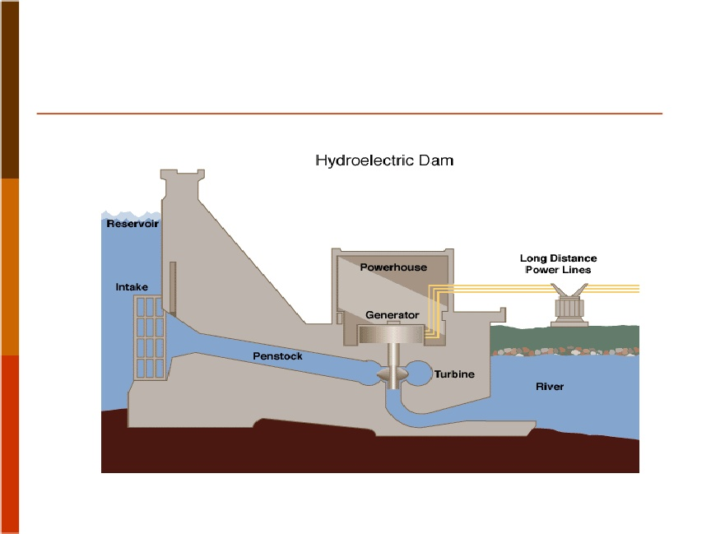

Slide 6
OVERVIEW
Nagarjuna Sagar was constructed and completed in 1950 across river krishna. To enable reversible mode of operation, storage of water is required on downstream of Nagarjuna Sagar power house. For this purpose N.S.Tail Pond is constructed at 21.65km river way distance from main dam with storage of 29.55million cu.m.(1.04 TMC) b/w (EL+75m) and (EL+74m) .
The power generation capacity is of 2X25 MW.
N.S.Tail Pond has 20 No.of radial gates with max. discharge capacity of 45,306 Cusecs. NSTPD consists of two penstocks each of 6.60m diameter.

Slide 7
CONTROL SYSTEMS
ELECTRO HYDAULIC GOVERNOR:
The programmable, microprocessor based EHG, having high accuracy, resolution and high speed of response has many additional advantages such as stability of set values, flexibility in designing and reduce wiring. The EHGC contains control circuitry & software for HMC of guide vane (GV) and RCC.
As it name indicate it has electrical sensing and hydraulic controlling. In electro hydraulic governing all transducers are electrical/electronic components. The acquired signals (of control valve lift, speed ,load & initial pressure etc..) are processed electronically and processed signal is introduced at a suitable point in the hydraulic circuit through a electro-hydraulic converter which is used as a connecting link between the electronic modules and valve actuators. Hydraulic signal before application to control valves servomotors is suitably amplified. EHG consists of three control loops for speed, load and pressure. EHG optimizes the turbine life by conservative operation with the aid of TSE. Actual speed of the turbine is measured by using hall probes. Speed regulation (Droop) can be changed from 2.5% to 8% in a step of 0.5% even when the machine runs on load. The usual setting of droop in EHG is 5%.Speed regulation (Droop) can be changed from 2.5% to 8% in a step of 0.5% even when the machine runs on load. The usual setting of droop in EHG is 5%.

Slide 8
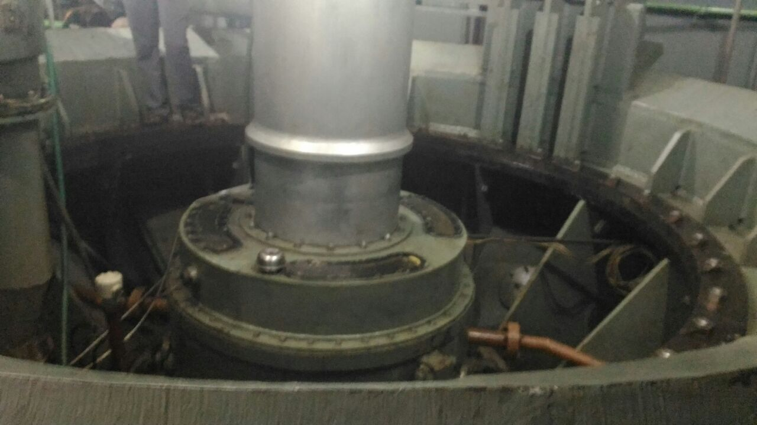
Hydraulic turbine governor is used for controlling the guide vanes by detecting turbine speed & its guide vane opening in order to keep turbine speed stable or to regulate its output.
The performance of the governor dominates the controllability of the power plant and quality of an electrical power produced .
LOWER BEARING OF RUNNER
SHAFT

Slide 9
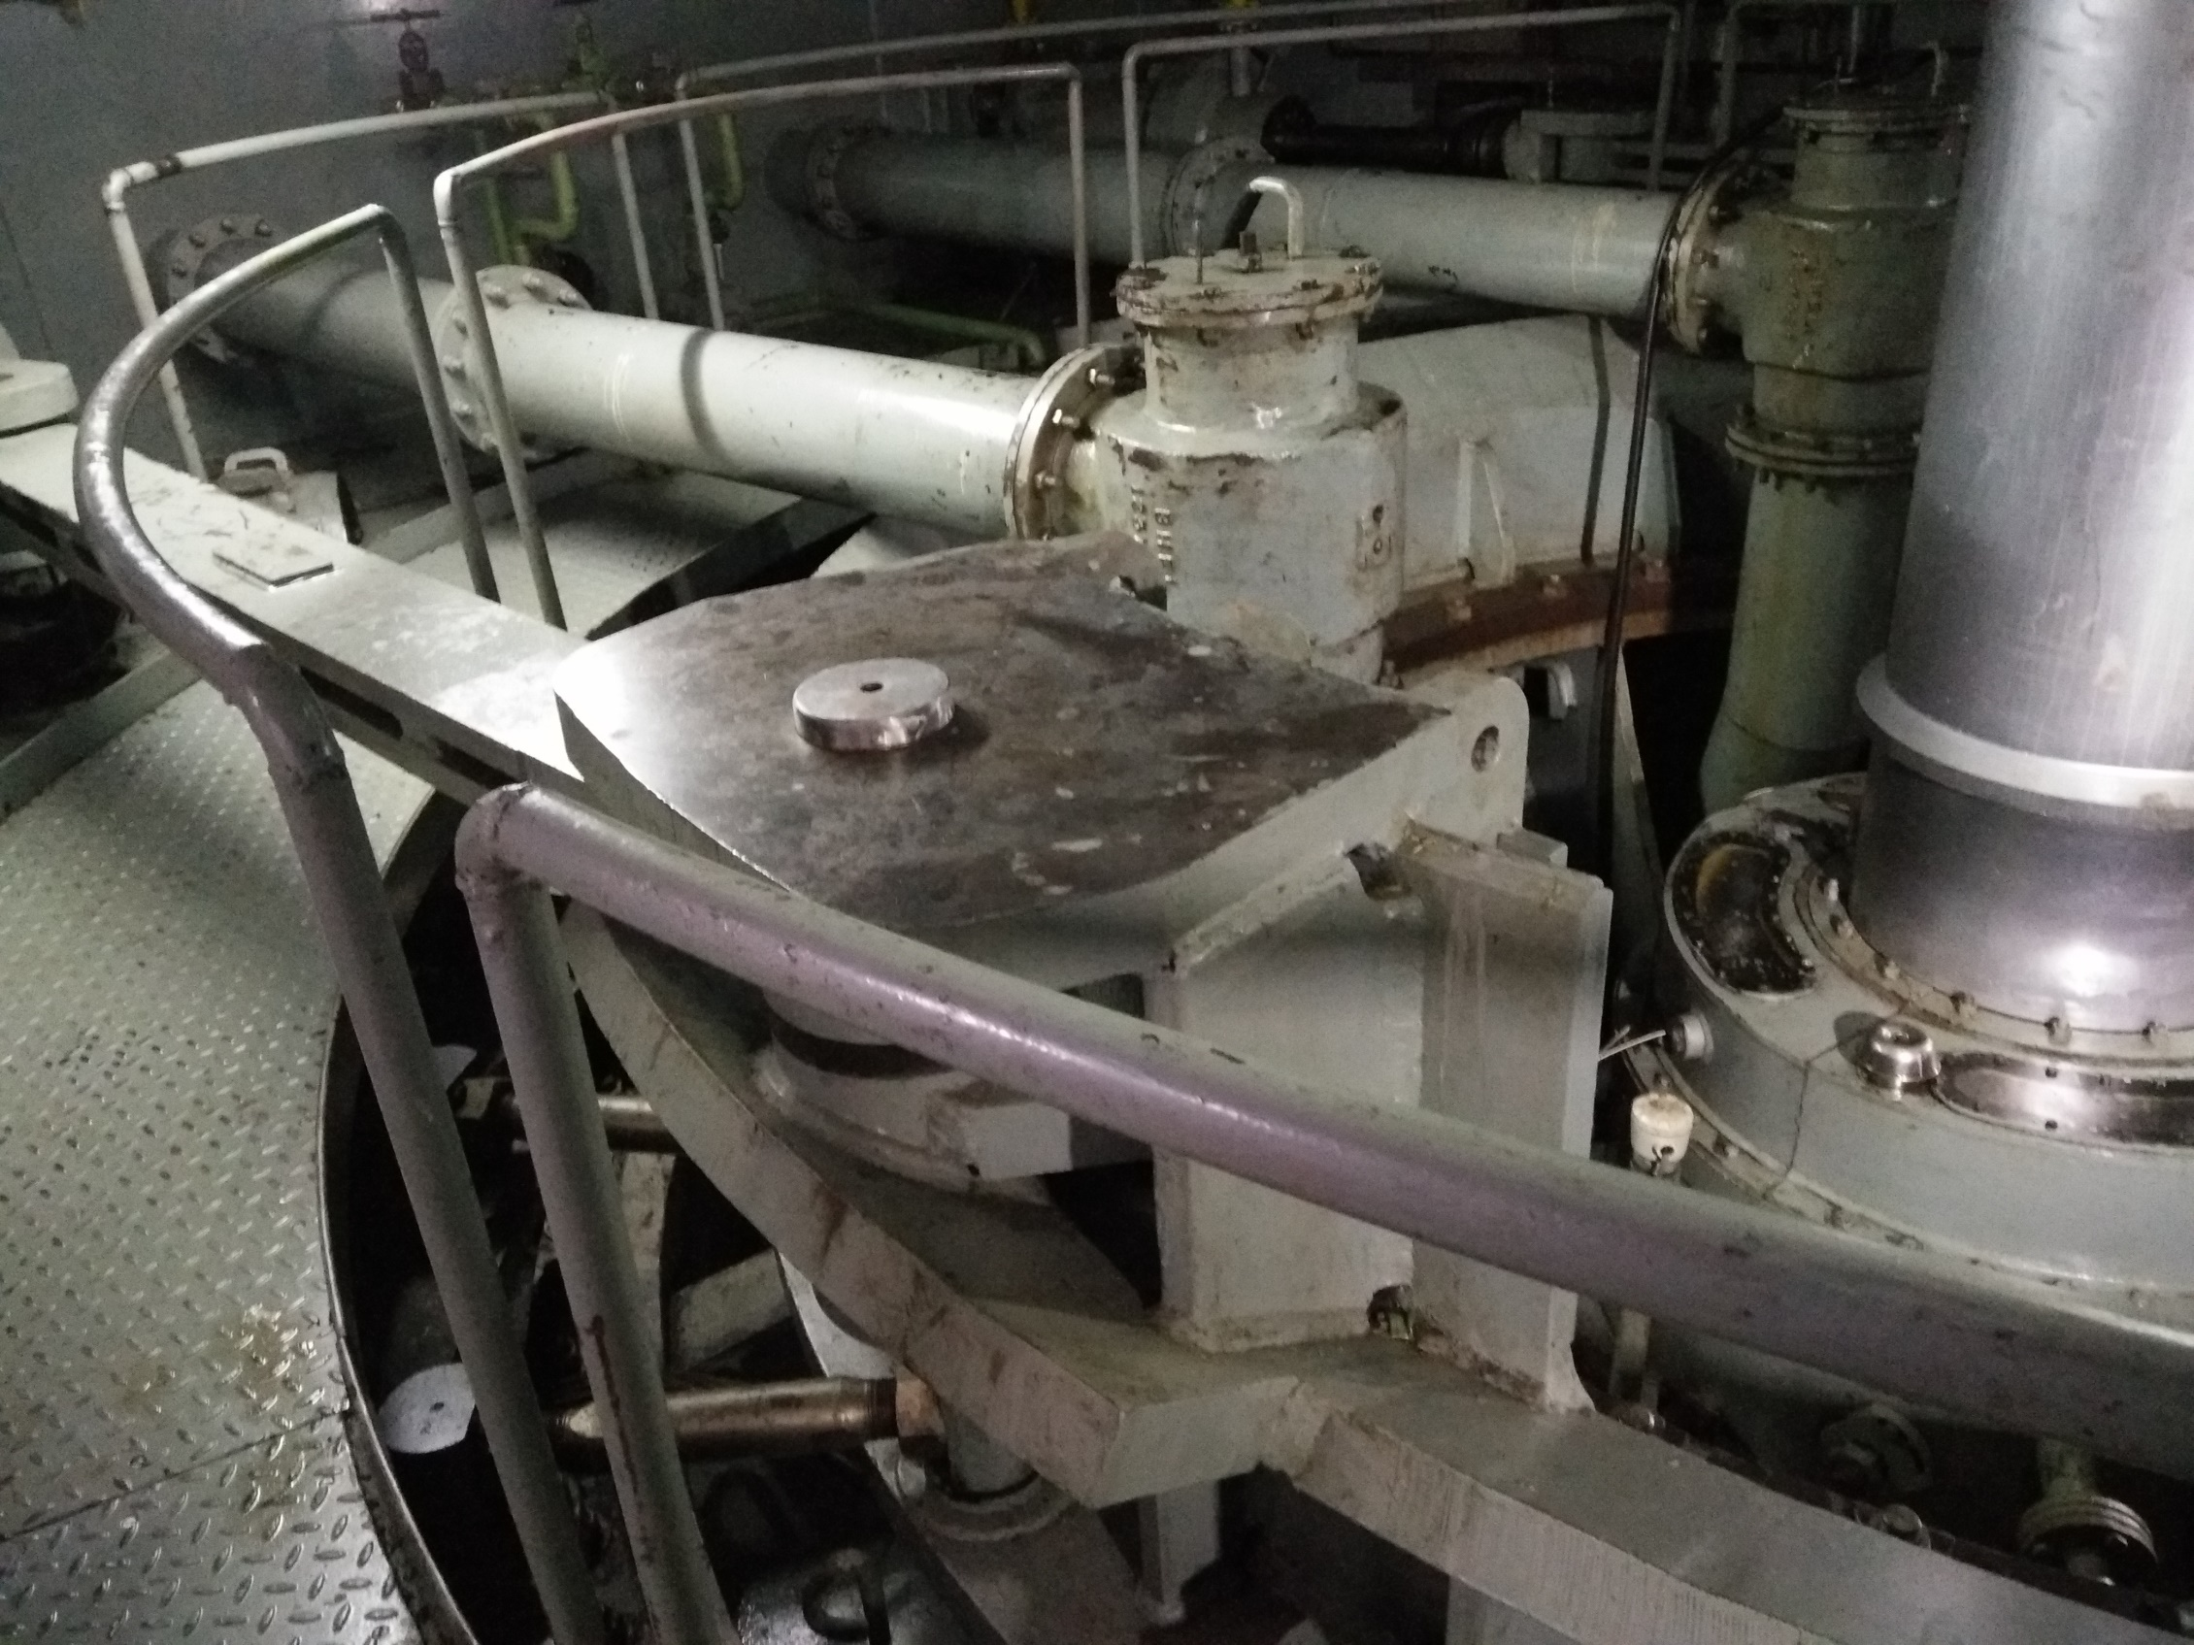
OIL for the bearings
Servo Mechanism

Slide 10
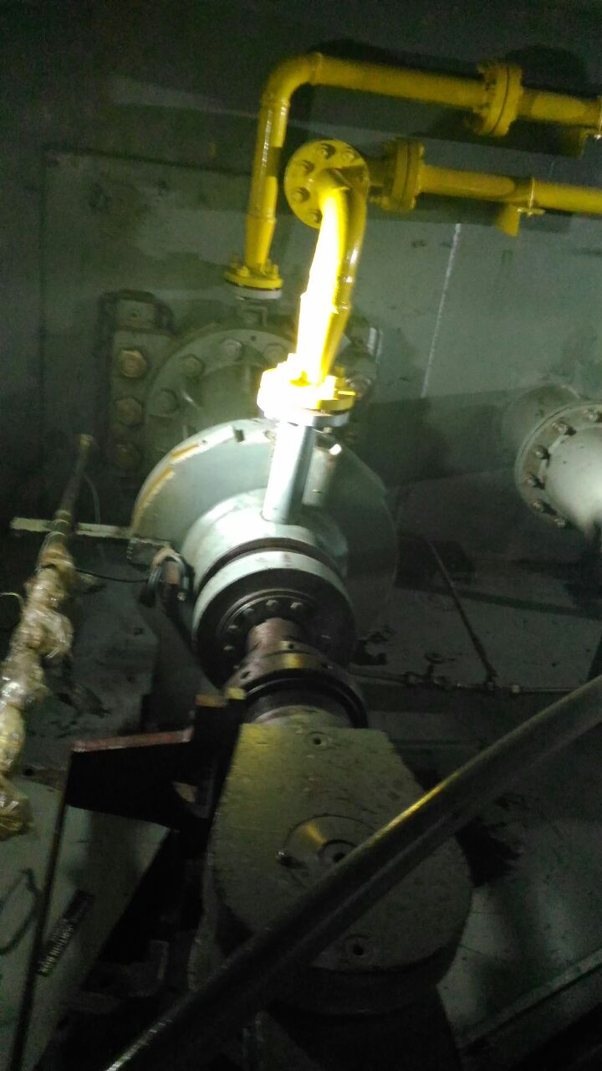
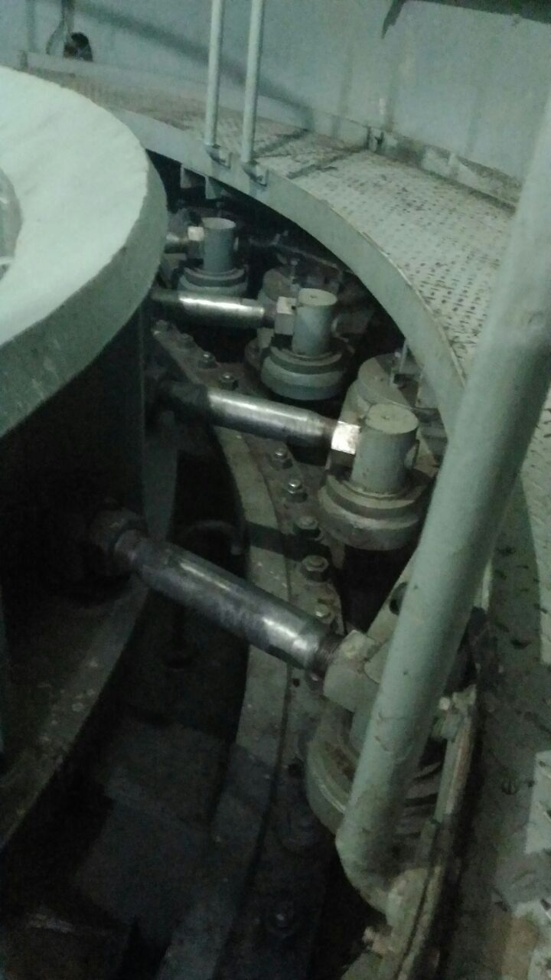
AIR
OIL
SERVO MOTOR
GUIDE VINES

Slide 11
HYDRO MECHANICAL CABINET
The main parts of HMC are speed sensing device, usually a ball head, an oil pressure system, hydraulic valves to control oil flow, and one or more hydraulic servomotors to move the wicket gates.
There is a interconnection b/w EHGC &HMC .
EHGC gives power supply to HMC to operate Guide Vanes by maintaining oil pressure through servo valve mechanism.

Slide 12
PROTECTION RELAY SYSTEM:
A relay is automatic device which senses an abnormal condition of electrical circuit and closes its contacts. These contacts in turns close and complete the circuit breaker trip coil circuit hence make the circuit breaker tripped for disconnecting the faulty portion of the electrical circuit from rest of the healthy circuit.
Types of relays:
Differential relays.
Inverse time relays with definite minimum time(IDMT)
Instantaneous relays.
Directional.
Distance.

Slide 13
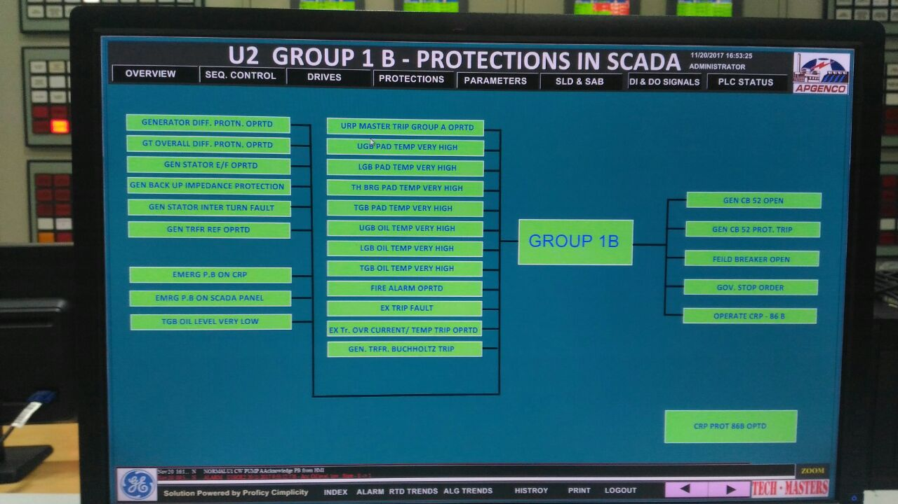

Slide 14
Annunciation system:
It is basically an audio visual alarm system, which highlights the fault or event which is going on, or even before it happens. This is very necessary for safety concern also, and sometimes the warning comes before improper procedure which warns the operator to avoid unwanted accident etc.
Latest models of annunciators are based upon microprocessor or microcontroller circuitry, which ensures the maximum reliability as well as enhanced wide ranges of features and functionalities.

Slide 15
Temperature measurement system:
It is used to sense the temperature
A temperature sensor is a device, typically, a Thermostat, Dial type thermometers, RTD, that provides for temperature measurement through an electrical signal.
It senses the temp. when heat is generated in lower guide bearing (LGB), upper guide bearing (UGB), and thrust bearing (THB), Turbine guide bearing(TGB)

Slide 16
Auto-synchronising system:
Synchronization of Generator with grid power supply is the process of equating the parameters like magnitude, phase and frequency of the both power sources and connecting the generator with the power system network.
The power generating plant should be connected to grid power system network to distribute the generated power or to receive power during start-up or on generator trip.
The generator frequency is to be matched with the grid frequency for proper synchronization.
There are two types of synchronizing procedures in the power plant i.e. Manual synchronizing and Auto-Synchronization.

Slide 17
scada system:
SCADA is a system operating with coded signals over communication channels so as to provide control of remote equipment (using typically one communication channel per remote station).” ... Communication infrastructure connecting the supervisory system to the remote terminal units.
Supervisory control and data acquisition (SCADA) is a control system architecture that uses computers, network data communications and graphical user interfaces, HMI for high-level process supervisory management which uses other peripheral devices such as programmable logic controllers and discrete PID controllers to interface to the process plant or machinery htrough LAN connectors.

Slide 18
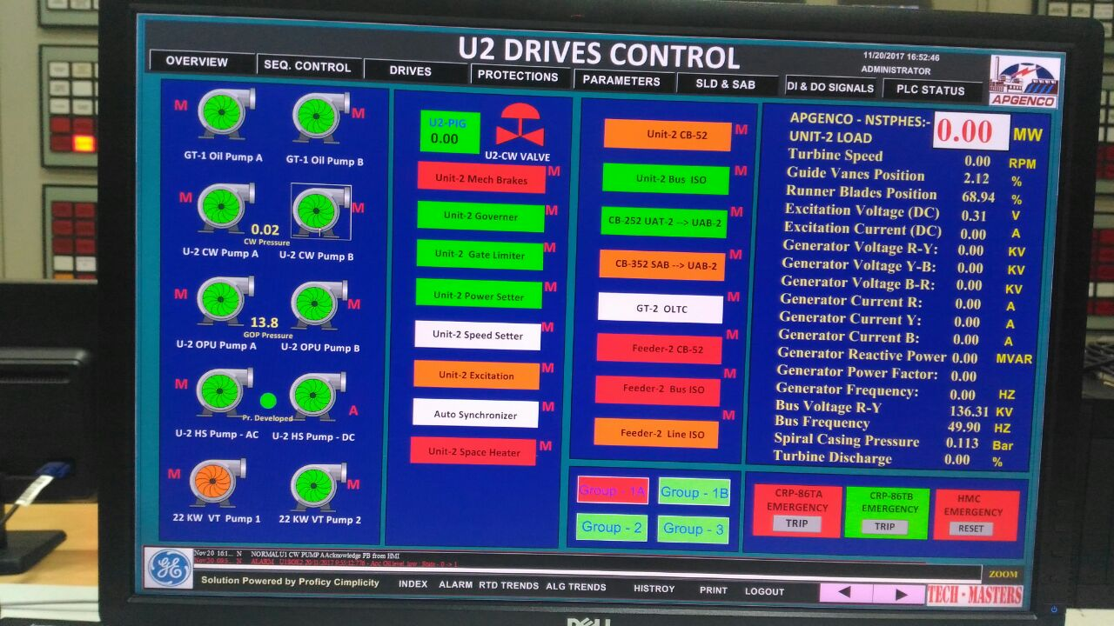
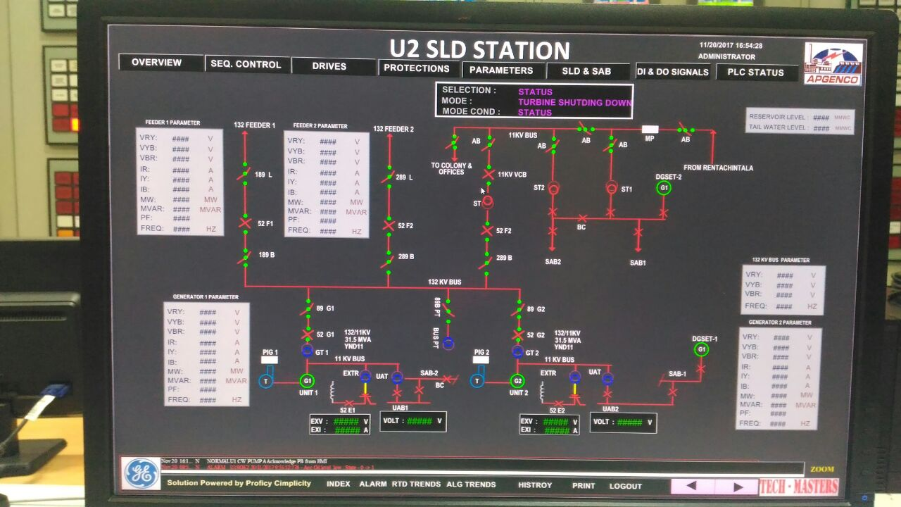

Slide 19
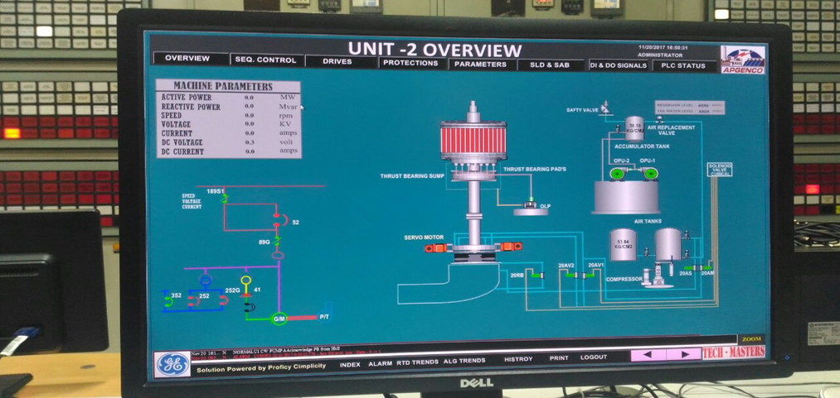

Slide 20
Oil pump unit
The normal functioning of Governor is dependant upon a reliable source of oil under pressure.
This pressure is maintained constant within the desired limits. The system consists of a pressure pumping set and pressure receiver.

Slide 21
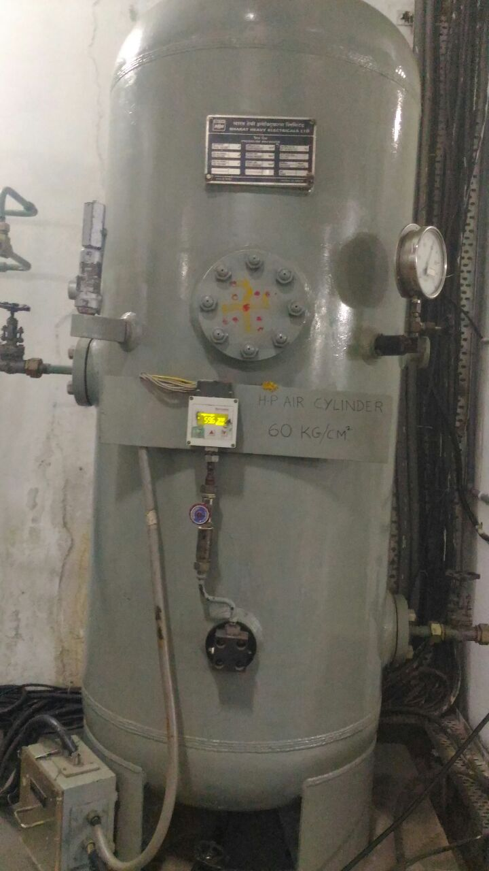

Slide 22
PRESSURE PUMPING SET
Each unit is provided with it’s own pumping set & has been designed to cater for the oil requirement of governor & Servomotors .
The system is designed to operate as main & standby.In the main mode on one of the pumps operates continuously and the other pump as standby operates when the oil pressure is lower than the preset value.pumping of oil into receiver is carried out by main oil pump motor under the control of pressure switch& logic control valve through solenoid operated valve.
Each P.P set is supplied with one sump tank. Each system has two logic control valves, two non return valves, one direct operated safety valve, two screw pumps with matching electic motors, one temperature sensing device, three oil level switch & one air breather along with its sump tank.

Slide 23
COOLING WATER SYSTEM
Each unit is provided with an independant CWS. for supplying water to Generator bearings, Generator air coolers, Turbine shaft seal, P.P set and Generator Transformer.
The cooling water has been taken from the respective Spiral casing. Each CWS. consist of bucket type Duplex strainer ,a booster pump, isolating and non return valves.
Booster pumps are used to boost the pressure of Penstock water to required pressure. Duplex strainer is provided to remove solids/suspended particles from cooling water .
A Differential pressure switch is provided across the strainer to indicate the clogging of the filter element.
A set of pressure gauges has also been provided to indicate the pressure of incoming & outgoing cooling water.

Slide 24
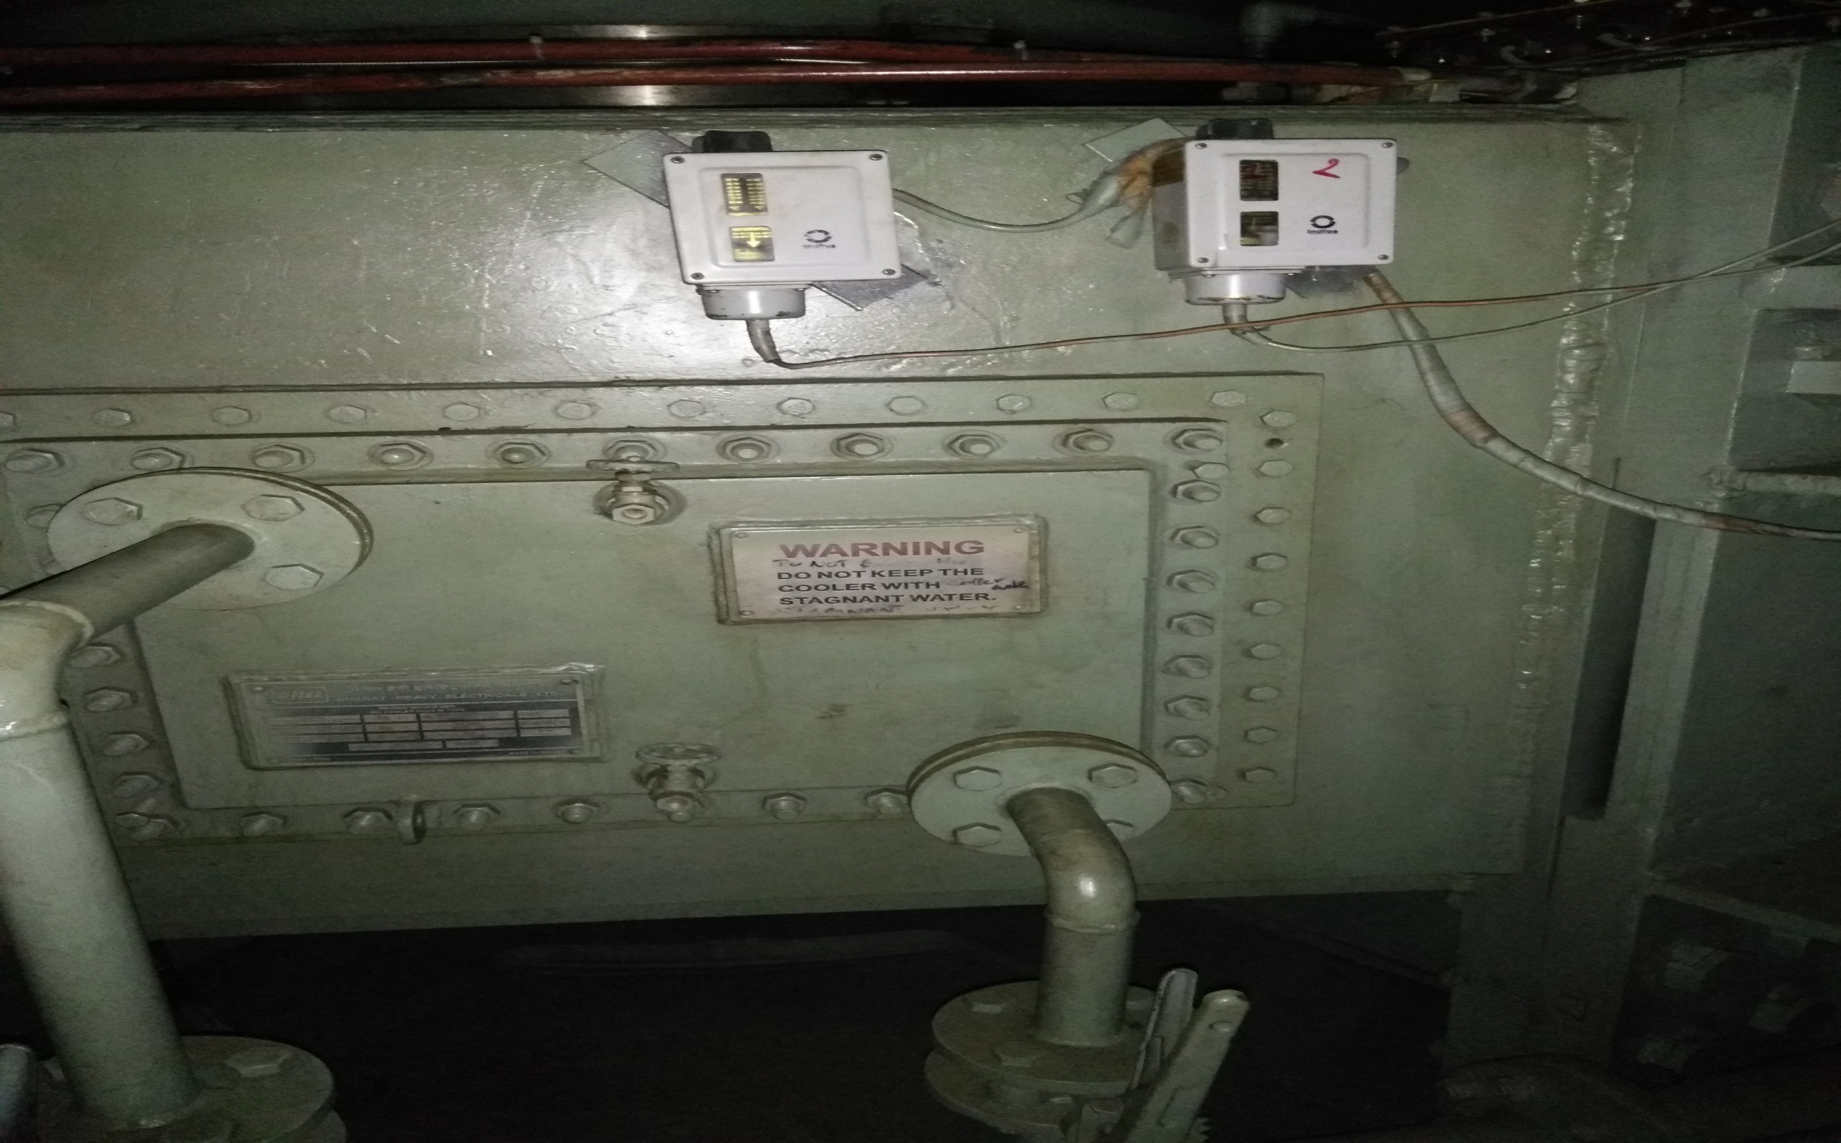
METERS
COOLING WATER TO THE ROTOR BEARING

Slide 25
DESCRIPTION OF TURBINE
The turbine is a vertical shaft kaplan type machine consisting of Draft tube,Spiral casing, Stay Ring, Guide apparatus, Servomotors, Shaft, Runner, Guide bearings, Shaft Seal, Oil tubes & Oil.
The Kaplan turbine is an outward flow reaction turbine, which means that the working fluid changes pressure as it moves through the turbine and gives up its energy. Power is recovered from both the hydrostatic head and from the kinetic energy of the flowing water. The design combines features of radial and axial turbines. Header and other Assemblies.

Slide 26
TWO TURBINES - Vertical shaft Kaplan type hydro turbine complete with
associated equipment and each shall comprise of following:
One Runner consists of a hub, set of cast stainless steel blades and blade turning mechanism and Runner cone along with bolts.
One Oil header for supply and distribution of oil to runner servomotor complete with oil pipes.
One Turbine shaft of forged carbon steel having guide bearing journal and integral flanges complete with coupling bolts and nuts and stainless steel sleeve.
One Turbine guide bearing of self oil lubricated pivoted pad type complete with necessary instruments and protective devices.
One Turbine shaft gland of water lubricated rubber type complete with connections for clean cooling water supply and protective devices.
One Top cover fabricated from steel plates and consisting of vacuum breaking valves, its piping, two pump-motor sets, one ejector with necessary controls.
One Pivot ring of fabricated construction.
One Set of guide vanes ( 24 No.s ) and bearing housing Guide vanes are
supplied complete with bearing housing & fittings.
One Set of guide vane regulating gear assembly consist of levers, links, shear pins and a fabricated regulating ring.
One Set of guide vane servomotors ( 2 No.s) consist of two double acting oil operated servomotors with piston, piston rings, piston rod etc.

Slide 27
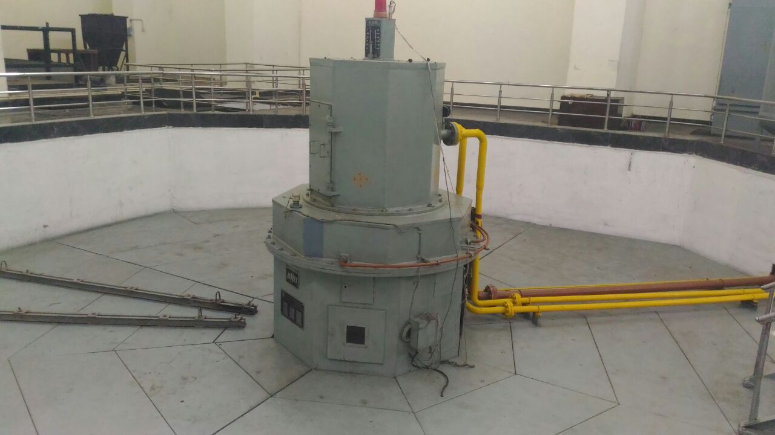

Slide 28
GENERATOR SYSTEM
A direct current (DC) is applied to the rotor winding of a synchronous generator to produce the rotor magnetic field. A prime mover rotates the generator rotor to rotate the magnetic field in the machine. A three-phase set of voltages is induced in the stator windings by the rotating magnetic field.
The electrical frequency of synchronous generators is synchronized (locked in) with the mechanical rate of rotation. The rate of rotation of the magnetic fields (mechanical speed) is related to the stator electrical frequency by (Np/120=f)
Large generators use brushless excitersfor supplying DC field current to the rotor. They consist of a small AC generator having its field circuit mounted on the stator and its armature circuit mounted on the rotor shaft. The exciter generator output (three-phase alternating current) is converted to direct current by a three-phase rectifier circuit also mounted on the rotor. The DC current is fed to the main field circuit. The field current for the main generator can be controlled by the small DC field current of the exciter generator, which is located on the stator

Slide 29
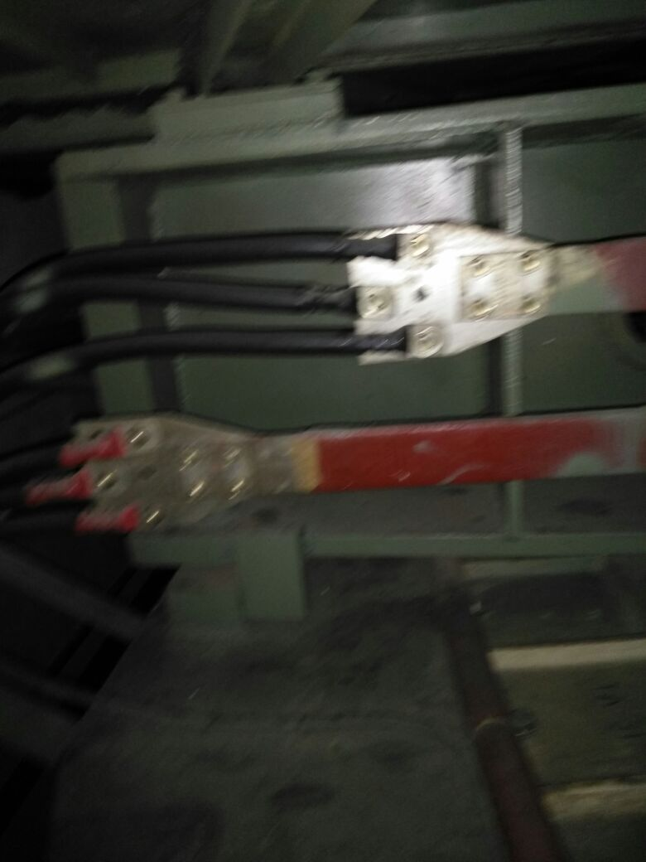
DC SUPPLY TO ROTOR

Slide 30
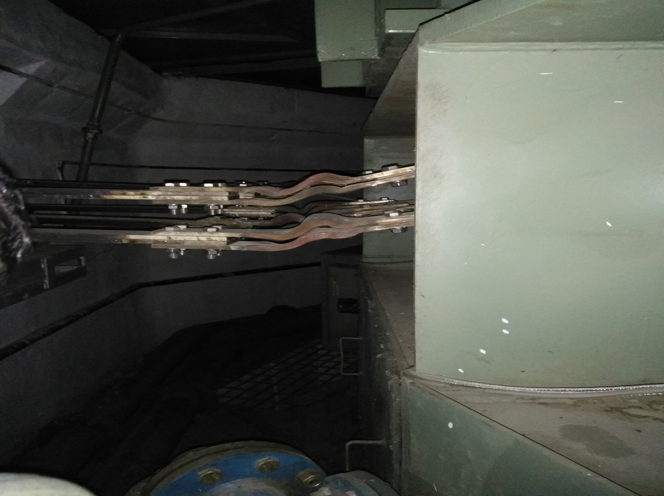
3 PHASE OUTPUT FROM STATOR

Slide 31
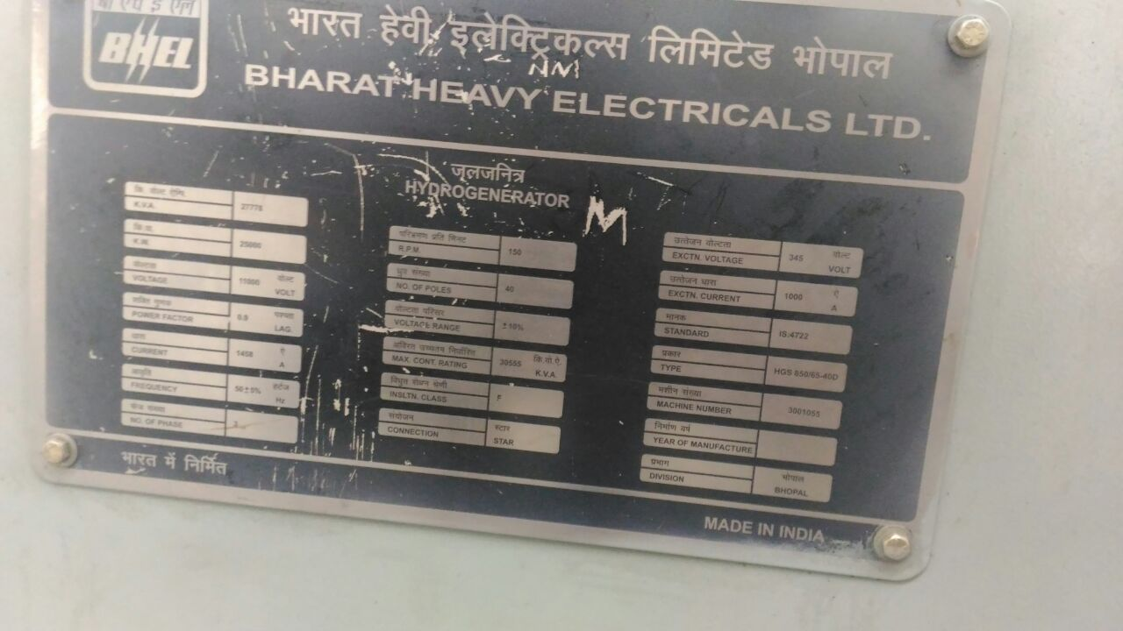
25 MW, 11 kV, 0.9 pf(lagging), 50 Hz, 3 Phase vertical shaft AC Generators having combined thrust and guide bearing below the rotor and one guide bearing above rotor with closed air circuit ventilation.
-
Notes:
SPECIFICATIONS OF ALTERNATOR

Slide 32
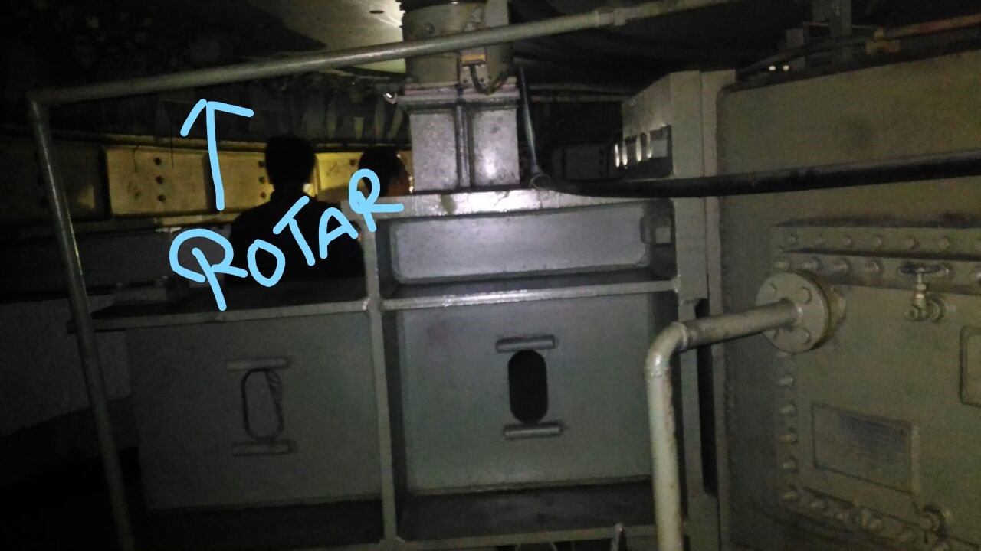

Slide 33
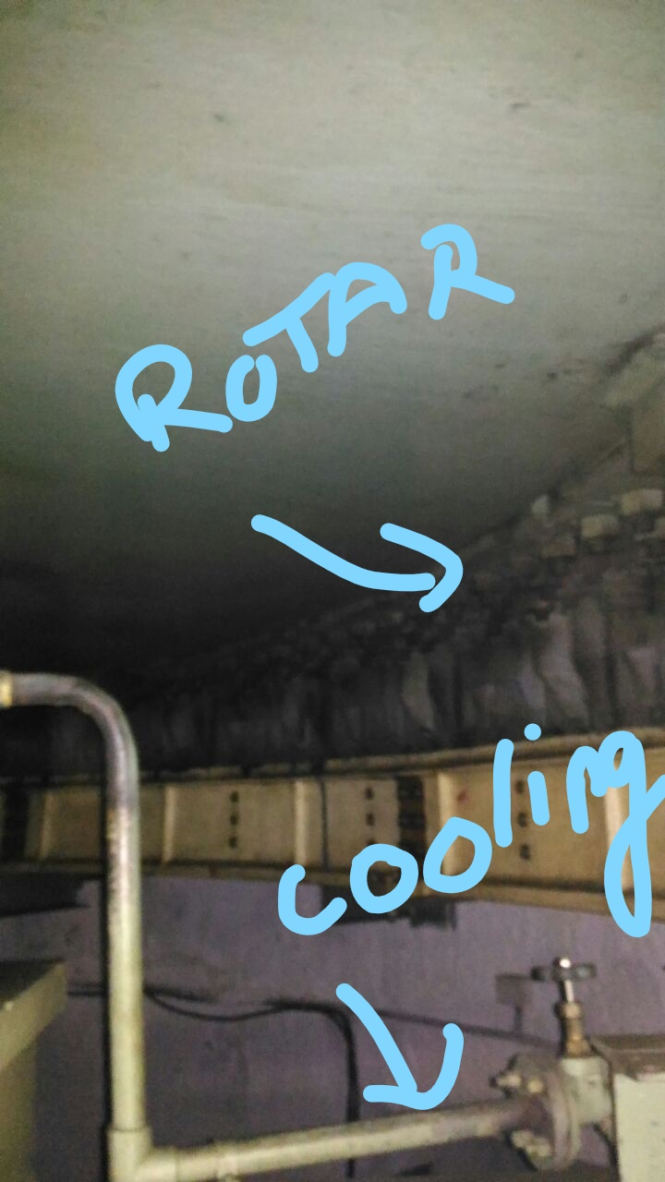

Slide 34
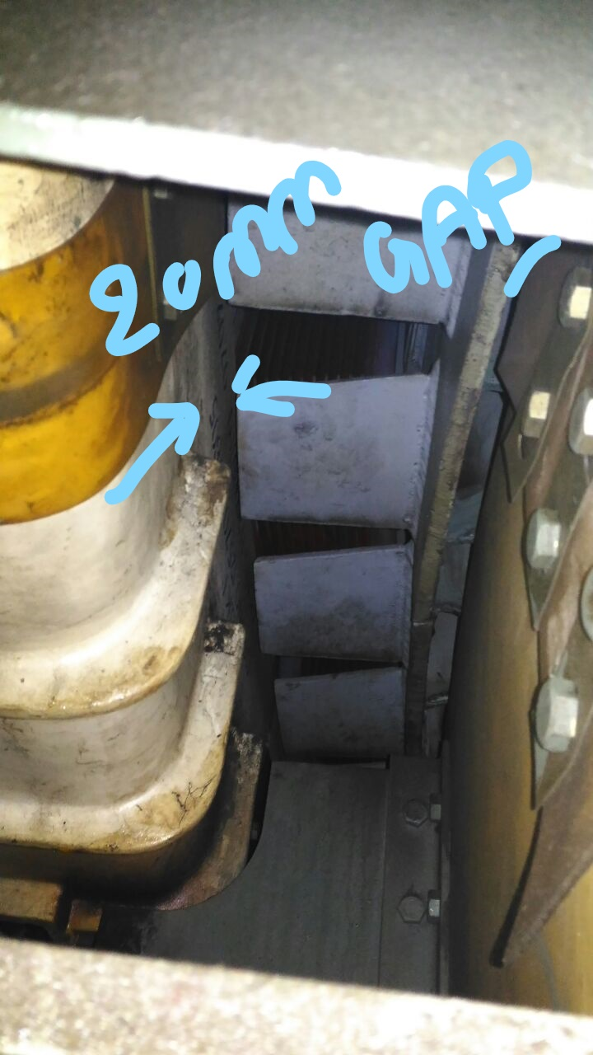

Slide 35
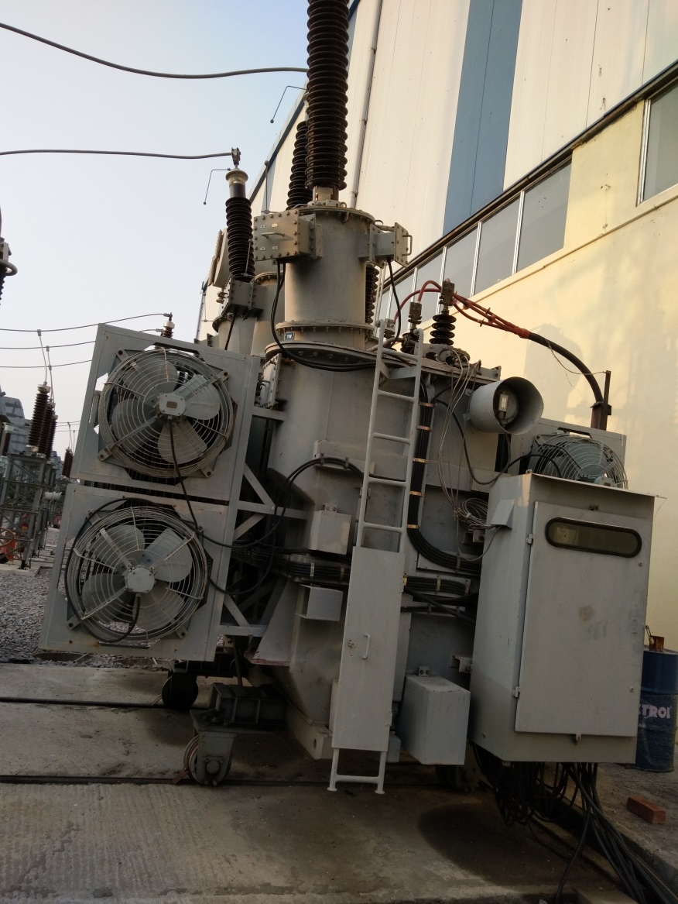
This nstpd switch yard has a different layout andit uses only 1 set of potential transformers, it is placed in between the 2 station transformers..

Slide 36
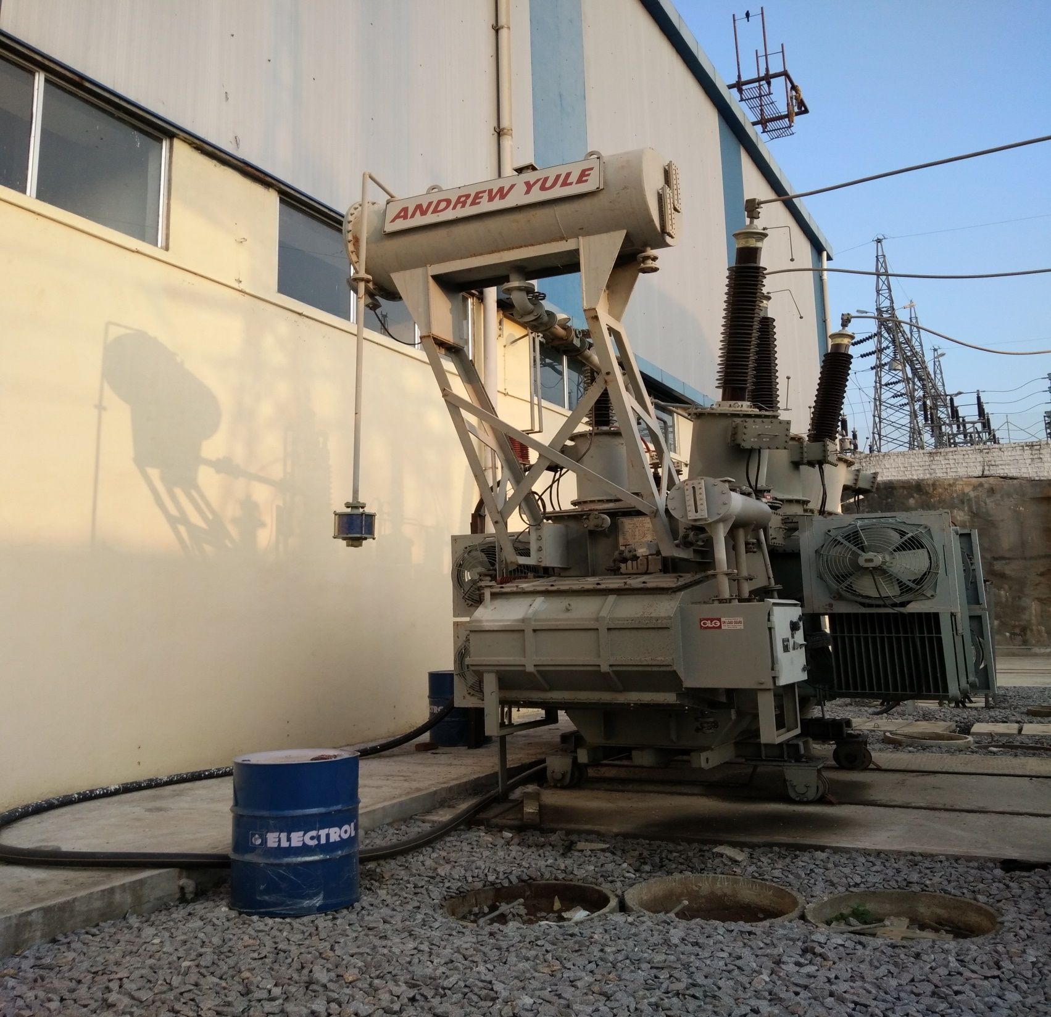

Slide 37
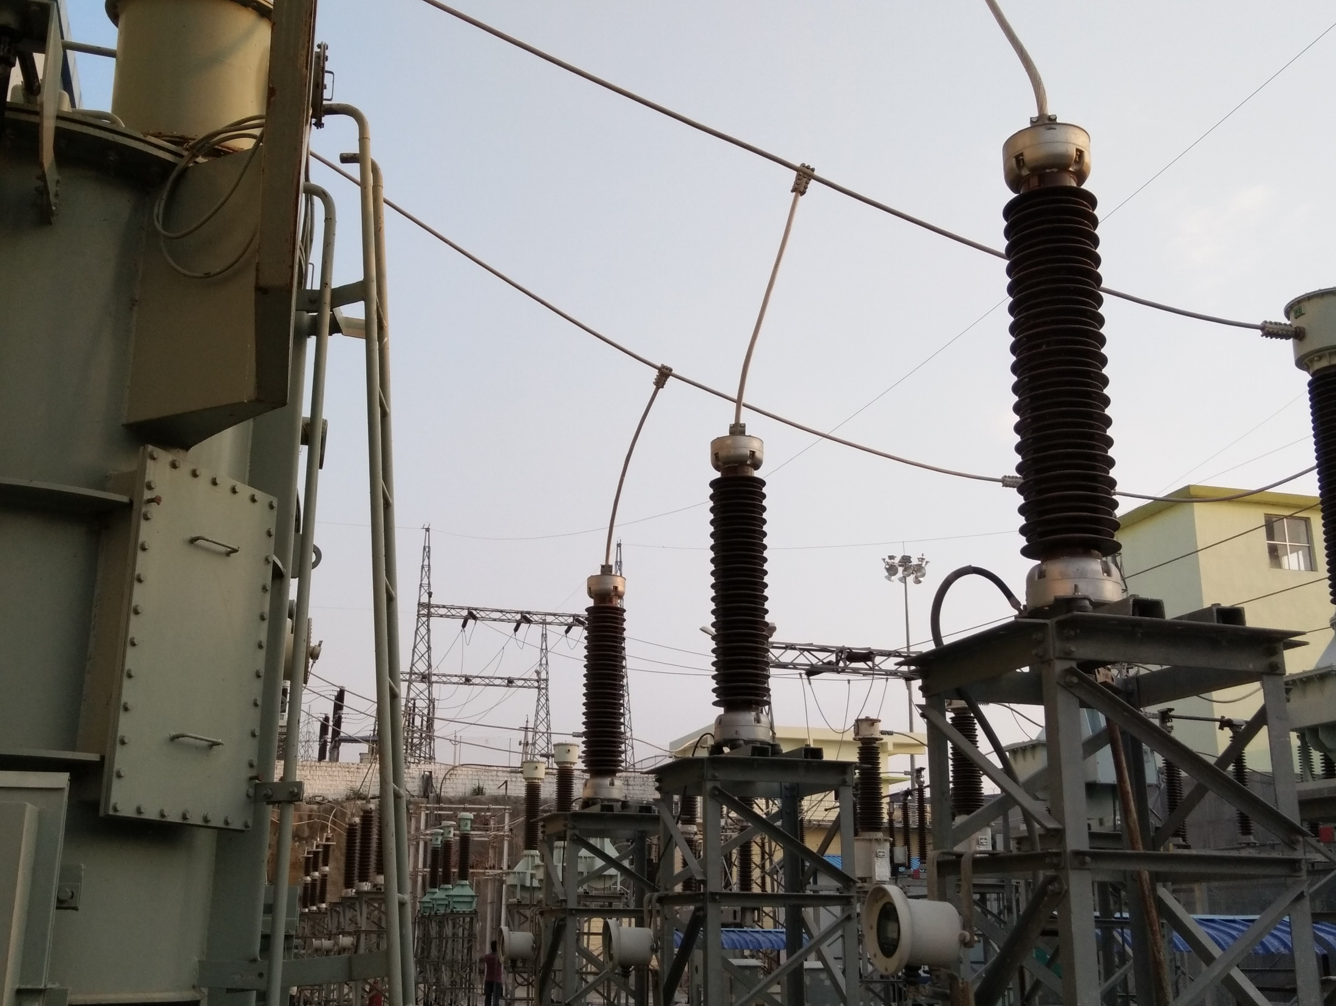
SURGE ARRESTER
SURGE METER
Notes:
Surge arresters

Slide 38
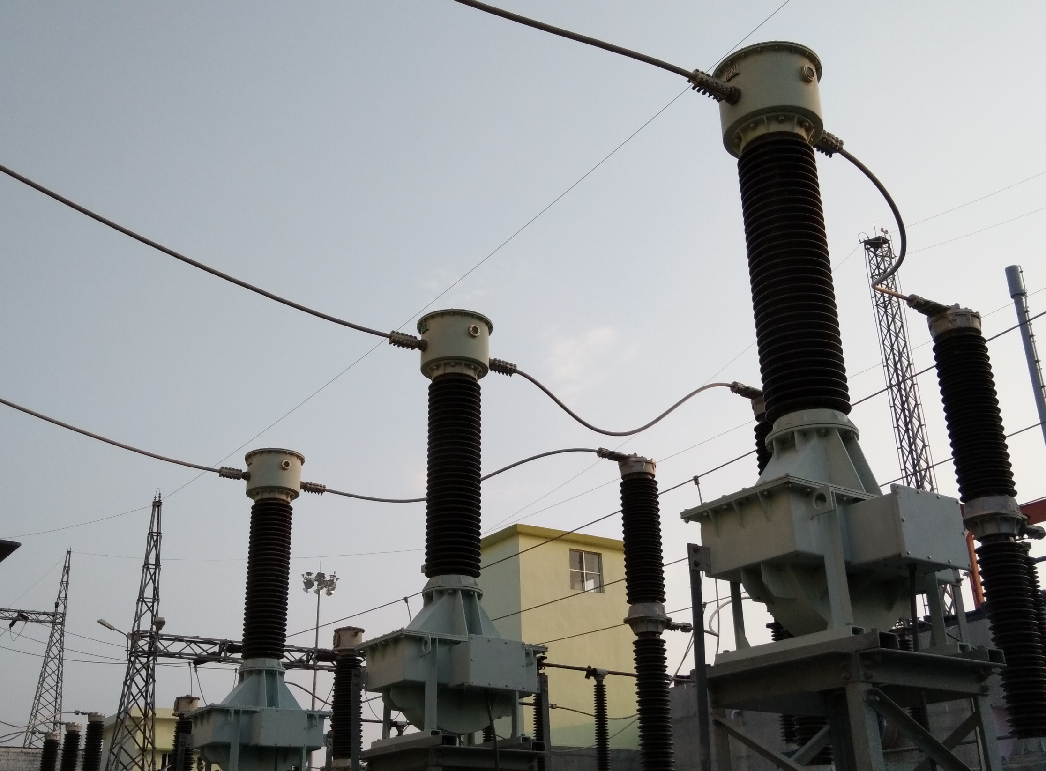
CURRENT TRANFOMER
Notes:
Current transfomers

Slide 39
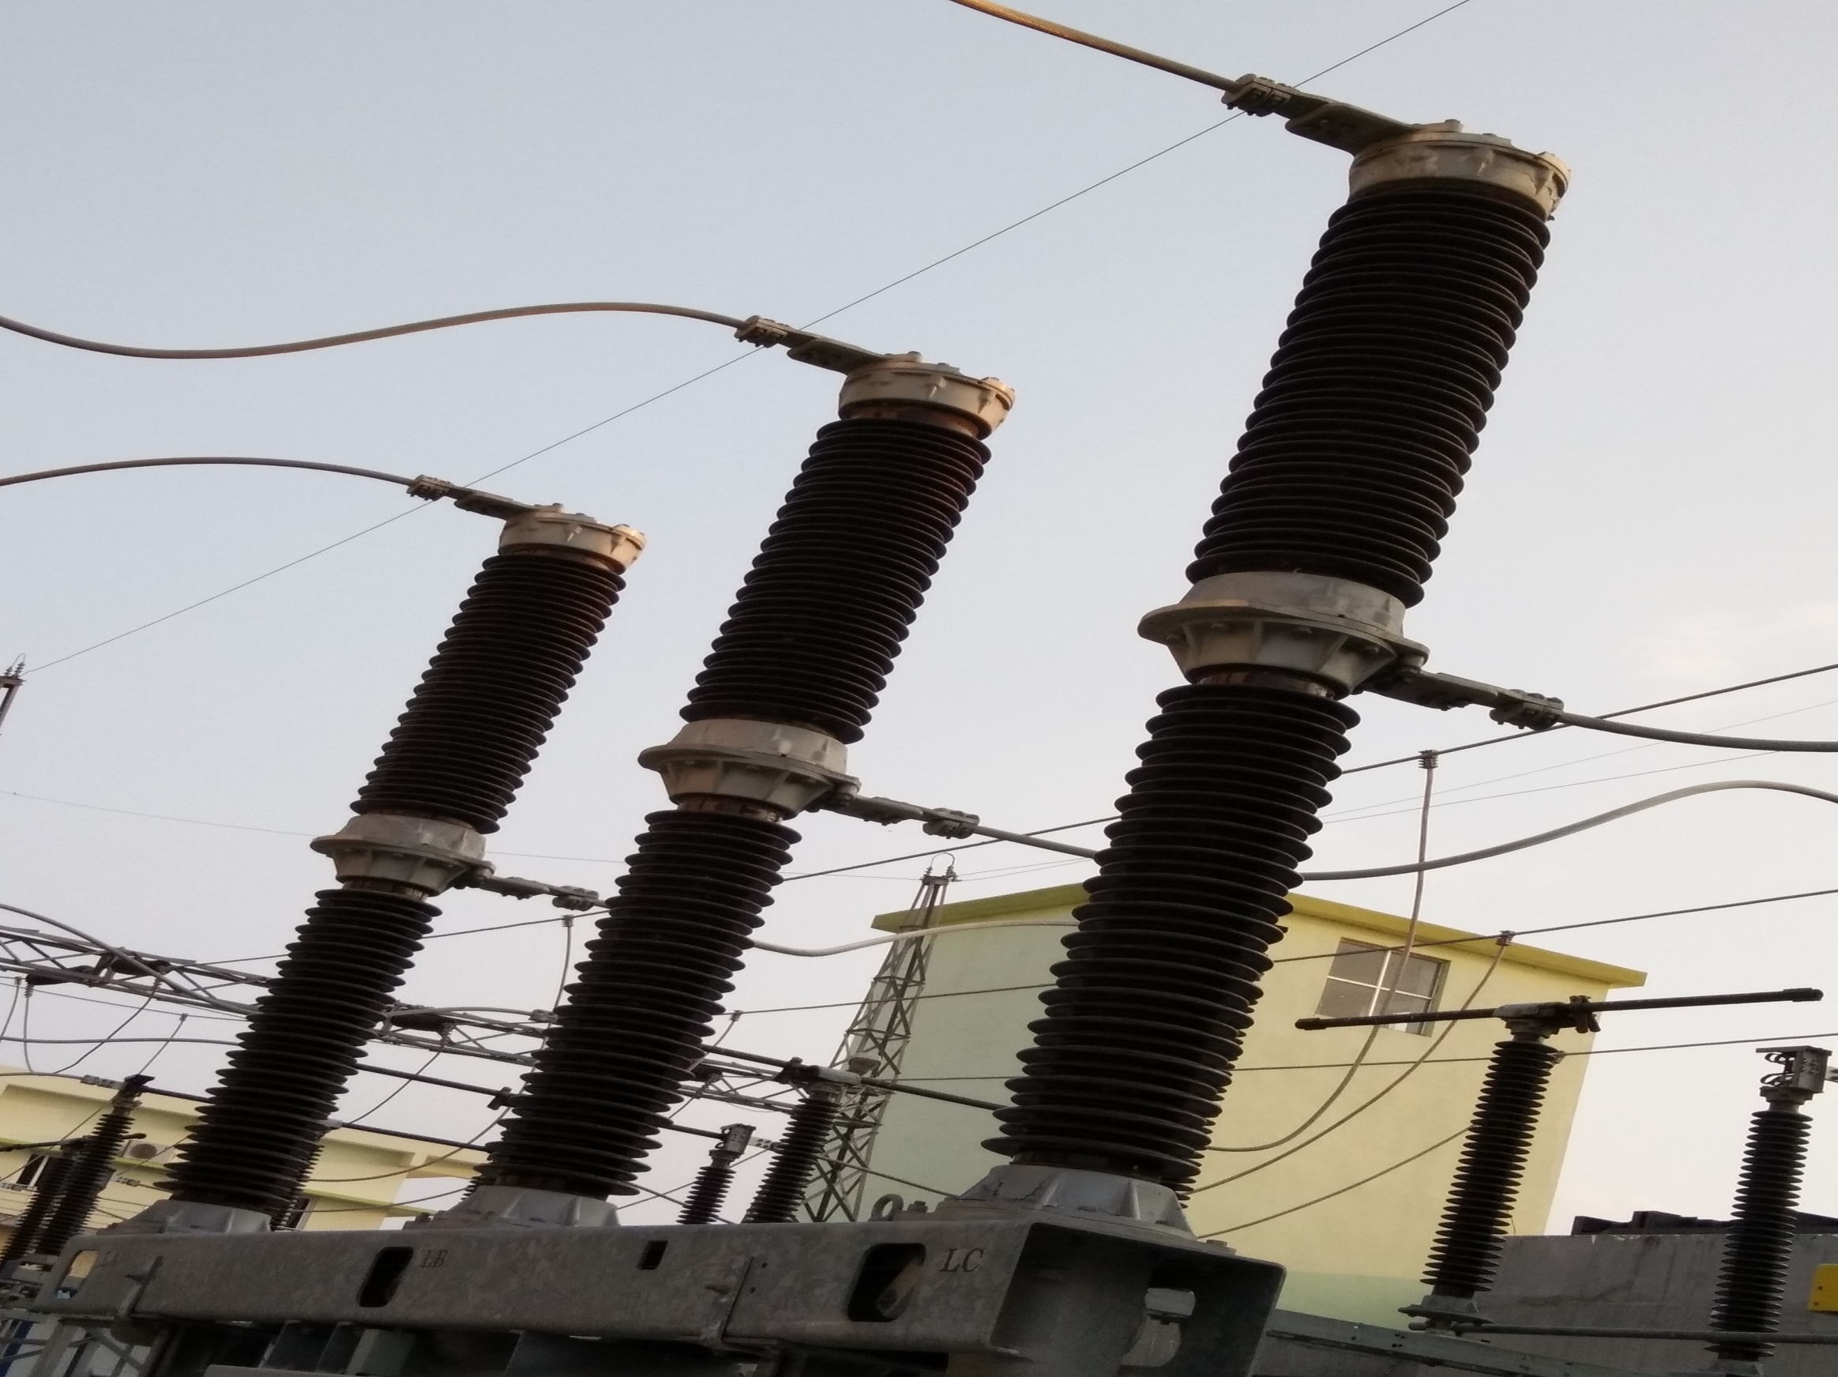
CIRCUIT BRAKER
Notes:
Circuit breakers (sf6)

Slide 40
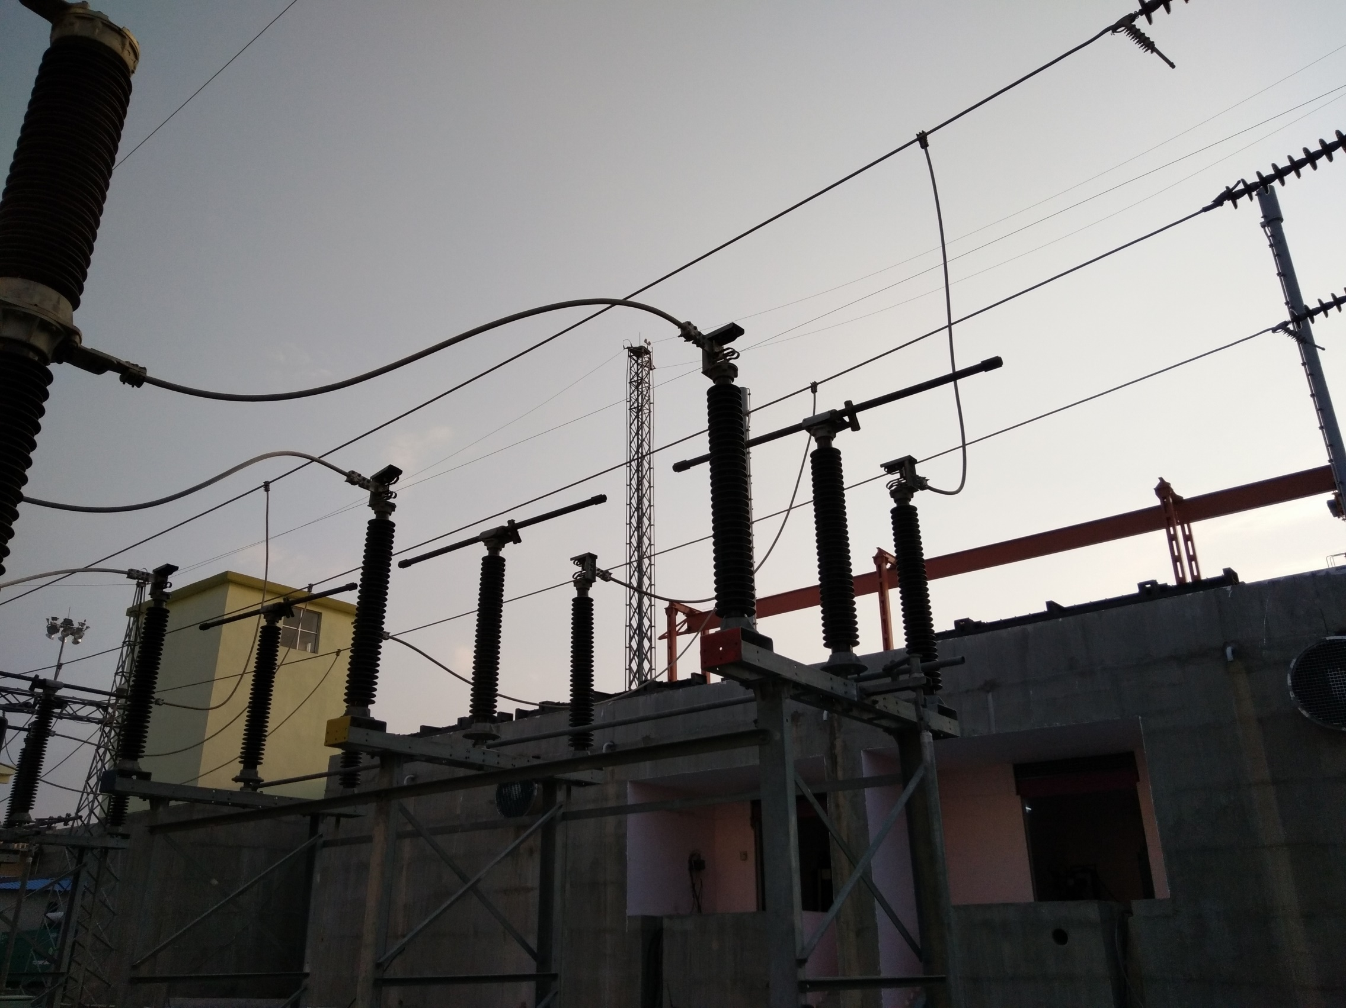
ISOLATOR
Notes:
isolators

Slide 41
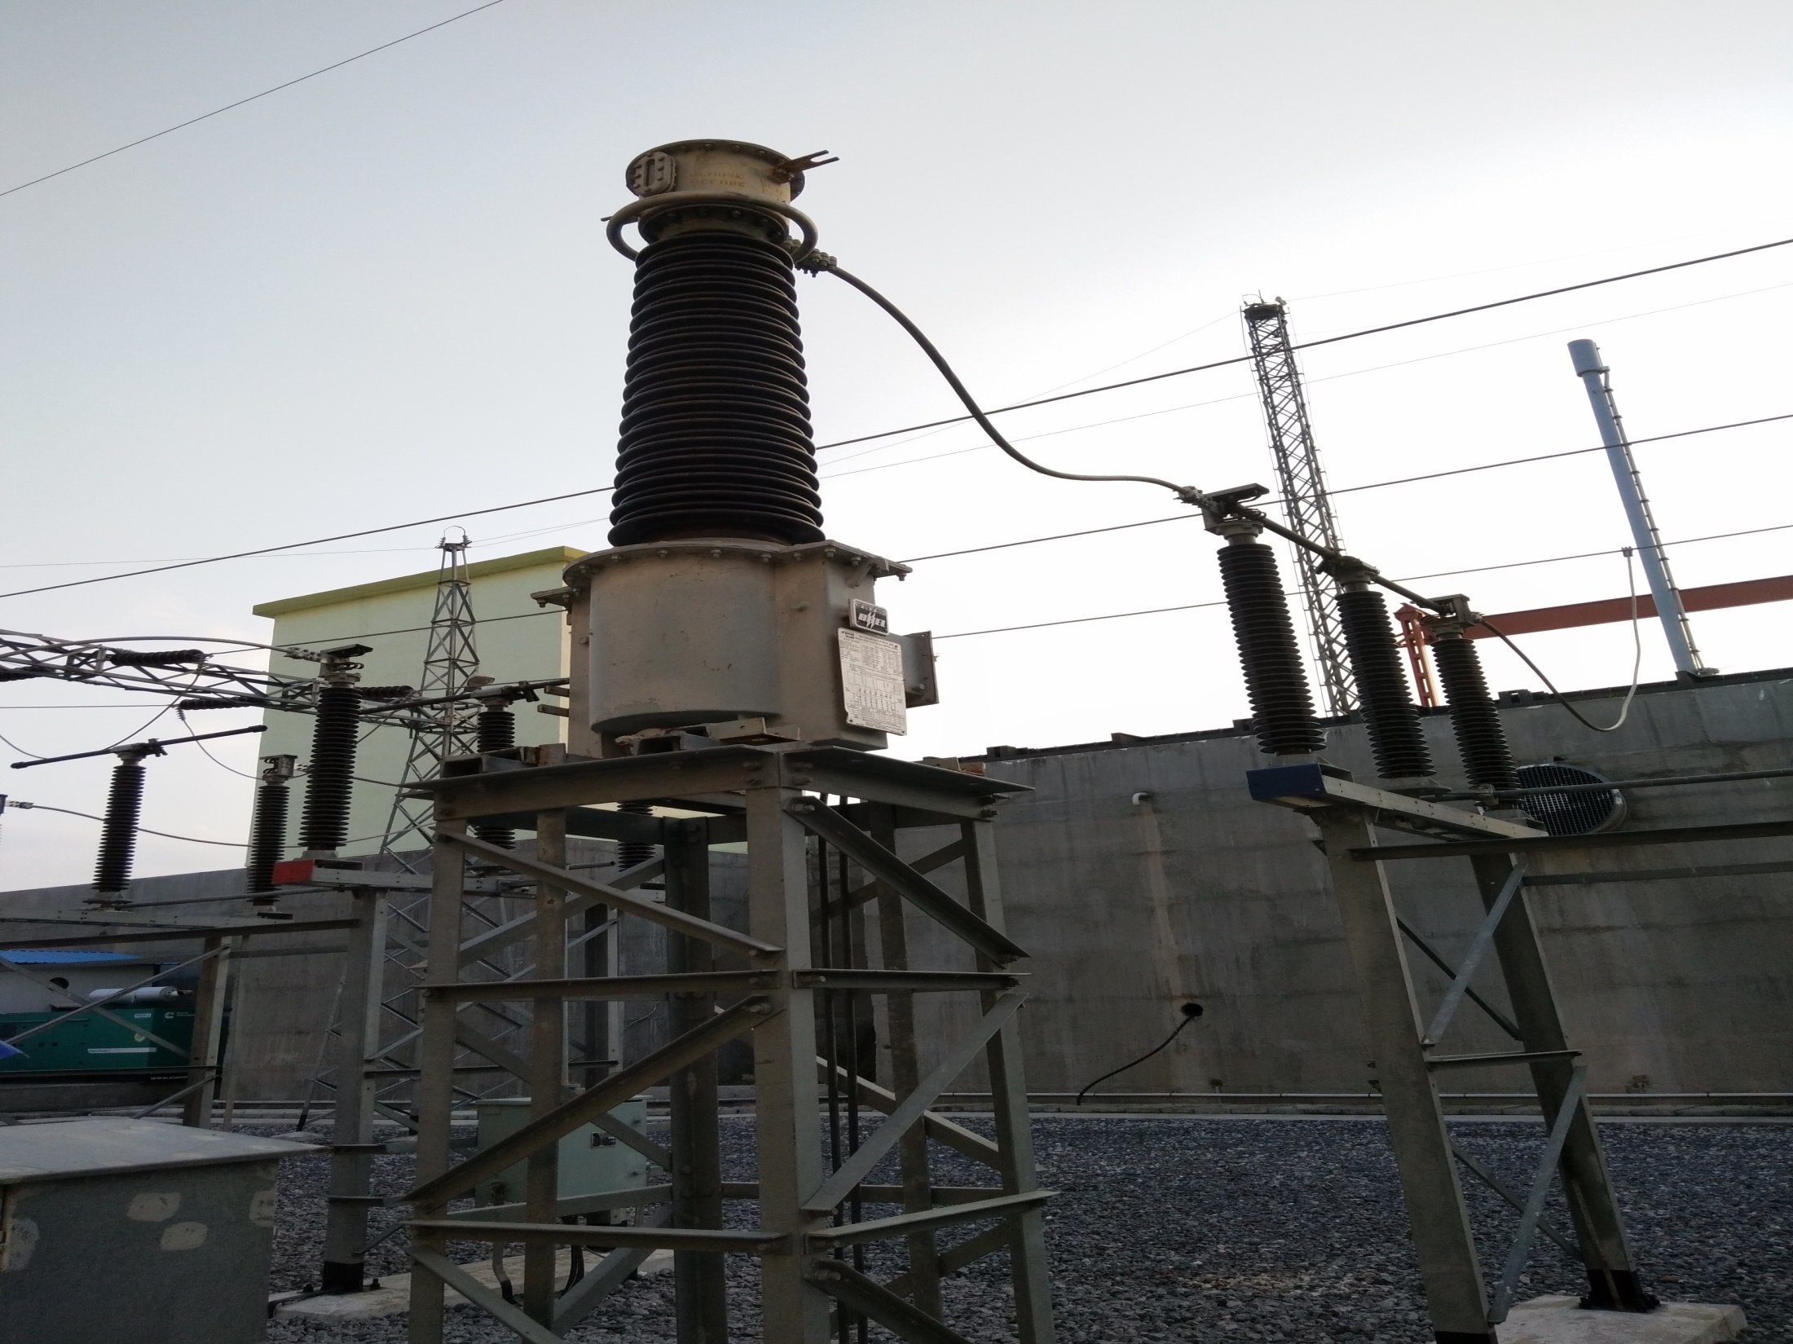
Bus bar
p.t
isolater

Slide 42
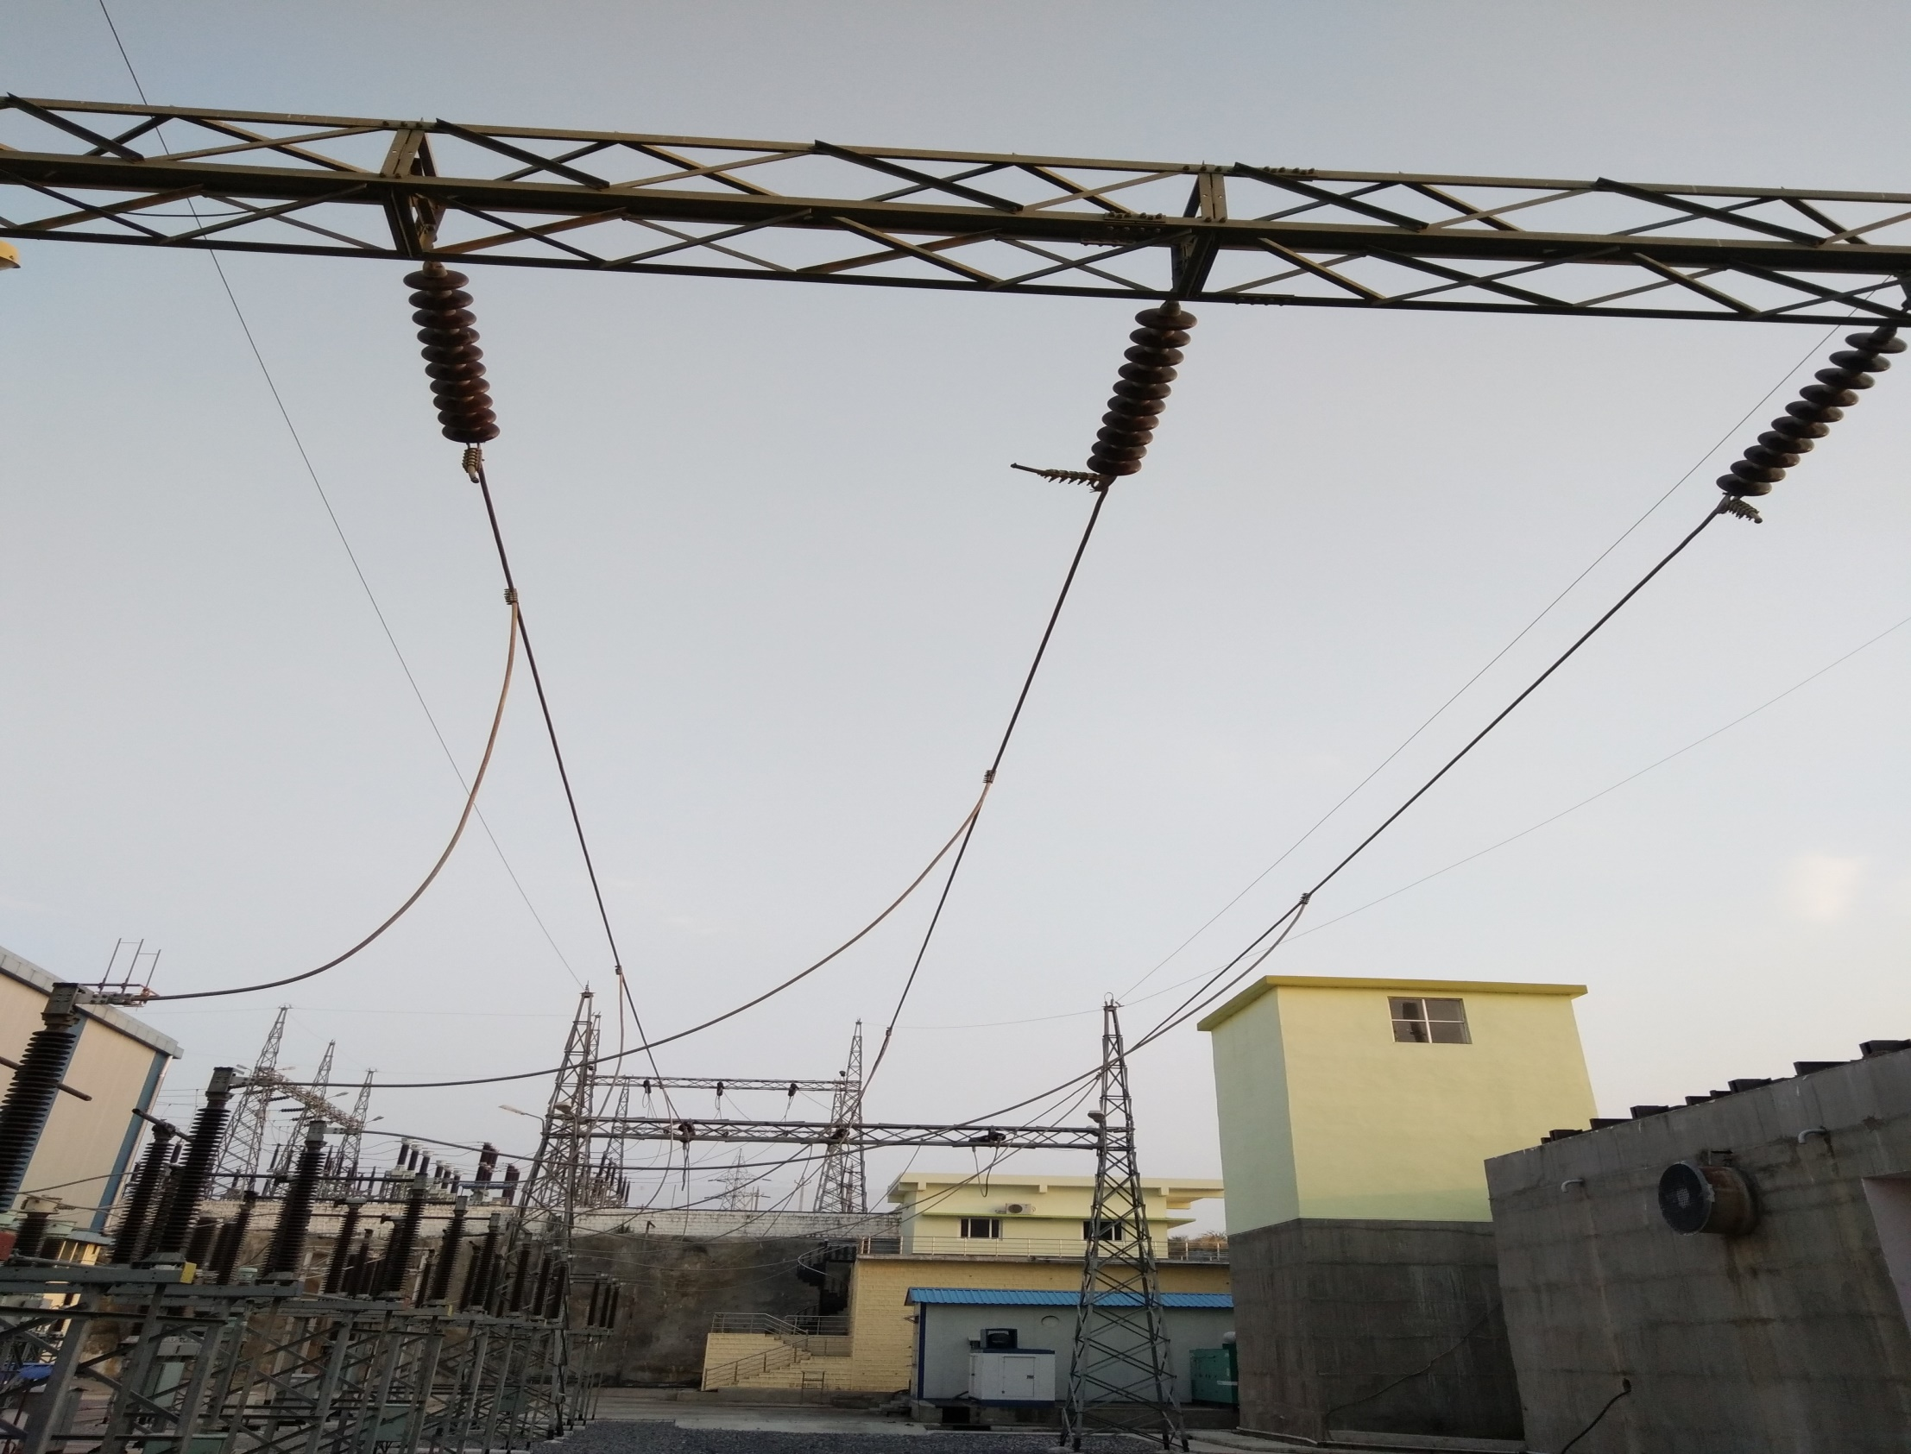
R Phase
B Phase
Y Phase
Grid
Notes:
Station feeder connecting to GRID

Slide 43
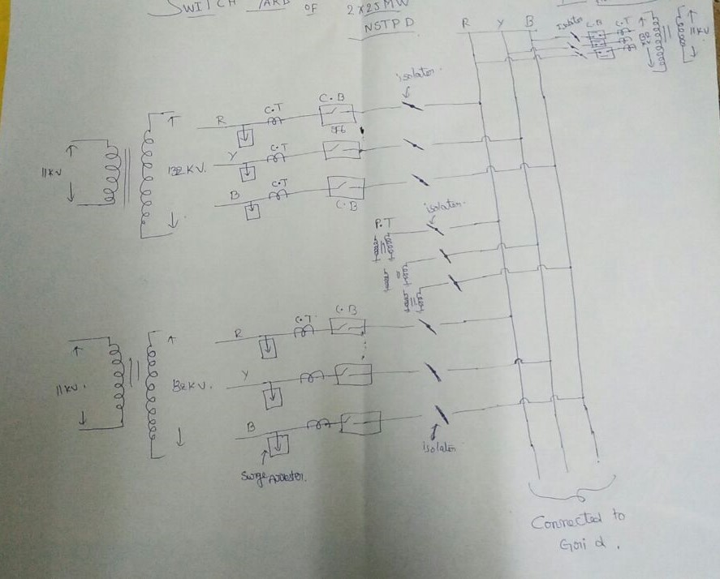

Slide 44
THANK Q
NARAYANA REDDY

